Slide 1
Public Libraries SA Future Proofing SA Libraries: How Social and Demographic Change Will Underpin Demand for Knowledge Facilitators Bernard Salt 10 September 2013

Slide 2
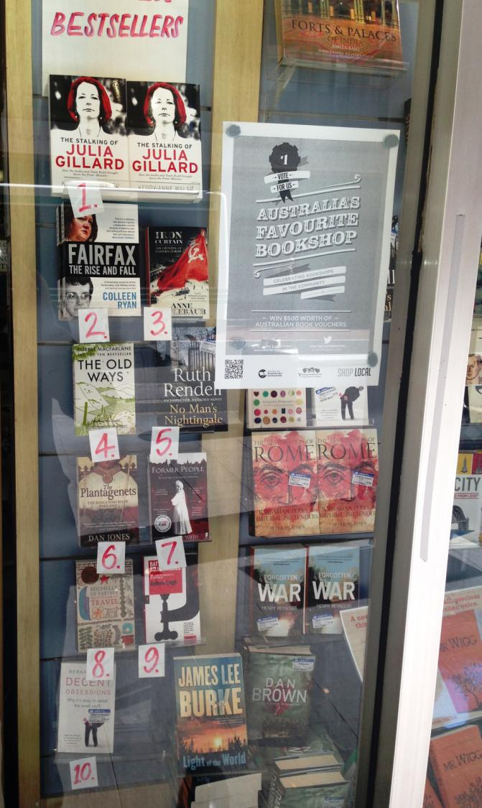
These slides are not for commercial use or redistribution. The information contained herein is of a general nature and is not intended to address the circumstances of any particular individual or entity. No one should act on such information without appropriate professional advice after a thorough examination of the particular situation. KPMG have indicated within this presentation the sources of the information provided. KPMG has not sought to independently verify those sources unless otherwise noted within the presentation. No reliance should be placed on additional oral remarks provided during the presentation, unless these are confirmed in writing by KPMG. KPMG is under no obligation in any circumstance to update this presentation, in either oral or written form, for events occurring after the presentation has been issued in final form. The findings in this presentation have been formed on the above basis. Forecasts are based on a number of assumptions and estimates and are subject to contingencies and uncertainties. Forecasts should not be regarded as a representation or warranty by or on behalf of KPMG or any other person that such forecasts will be met. Forecasts constitute judgment and are subject to change without notice, as are statements about market trends, which are based on current market conditions. Neither KPMG nor any member or employee of KPMG undertakes responsibility arising in any way from reliance placed by a third party on this presentation. Any reliance placed is that party’s sole responsibility. The presentation (and the accompanying slide pack) is provided solely for the benefit of the conference attendees and is not to be copied, quoted or referred to in whole or in part without KPMG’s prior written consent. KPMG accepts no responsibility to anyone other than the conference attendees for the information contained in this presentation.

Slide 3
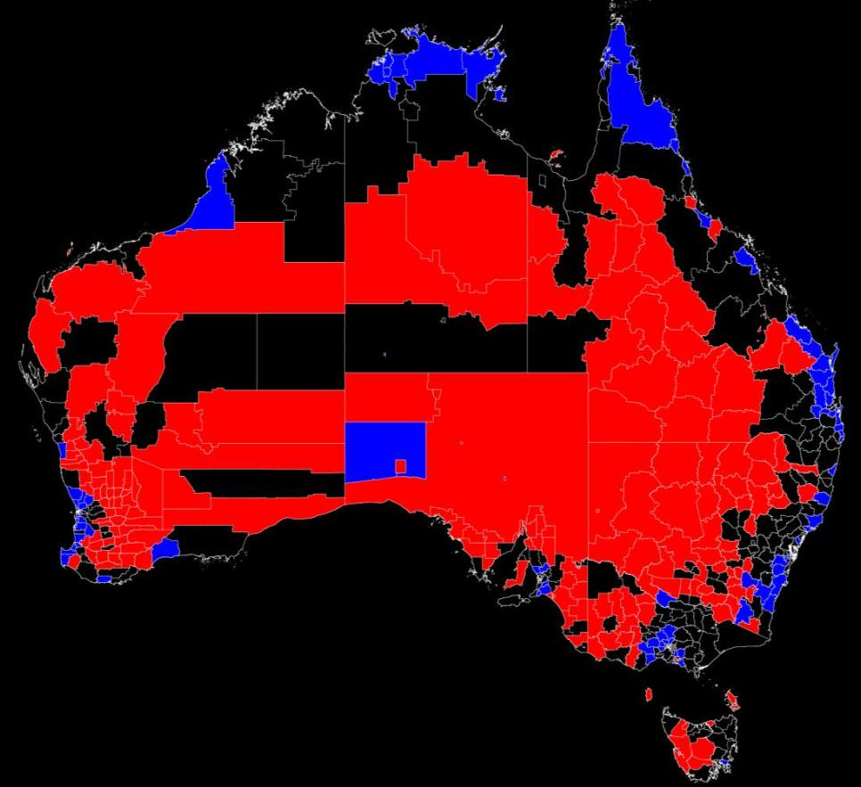
Australians are reluctant to move inland from the capital cities or the coast
Areas of high population growth (>2% pa) and loss (<-1% pa) between 1986 and 2011
DARWIN
Cairns-Port Douglas
Broome
TOWNSVILLE
Karratha
Mackay
FIFO WEST
Gladstone
FIFO EAST
Bundaberg
Hervey Bay
Sunshine Coast
FIFO
CENTRAL
Gold Coast
Geraldton
Byron Bay
Coffs Harbour
PERTH
Port Macquarie
Port Stephens
Augusta-
Margaret
River
Narooma
Denmark
Victor Harbor
Winners
Surf Coast
Sorell
Losers
Source: Based on Australian Bureau of Statistics data; KPMG Demographics

Slide 4
The Chinese and Indians are shaping South Australia’s ethnic mix
Country of Birth 2011
United Kingdom 122,300
Italy 20,700
India 18,700
China 15,900
New Zealand 12,900
Vietnam 12,000
Germany 11,400
Greece 9,800
Philippines 8,900
Netherlands 7,300
2006 % change
121,100 1%
22,500 -8%
6,800 174%
8,100 97%
11,400 13%
10,500 14%
12,000 -5%
10,800 -10%
5,400 63%
7,800 -7%
Top 10 ethnicities in South Australia at the 2011 and 2006 Censuses
Source: Based on Australian Bureau of Statistics data; KPMG Demographics

Slide 5
Volunteering, belief and support services varies by suburb and town throughout South Australia
Proportion volunteers *
Belief *
Disability *
Keith 41%
Jamestown 40%
Crystal Brook 40%
Streaky Bay 40%
Burra 39%
Kingscote 39%
Meningie 39%
Port Broughton 38%
Burton 9%
Australian average 19%
Newton 85%
Waterloo Corner 85%
Fulham Gardens 85%
Kidman Park 84%
Netley 83%
Croydon Park 83%
Findon 82%
Ferryden Park 81%
Sellicks Beach 51%
Australian average 75%
Morphettville 16%
North Brighton 15%
North Plympton 15%
Angle Park 15%
Hendon 14%
Goolwa 14%
Glynde 14%
Cowandilla 13%
Roxby Downs 1%
Australian average 5%
* Excludes suburbs with total population less than 1,000
Source: Based on Australian Bureau of Statistics data; KPMG Demographics

Slide 6
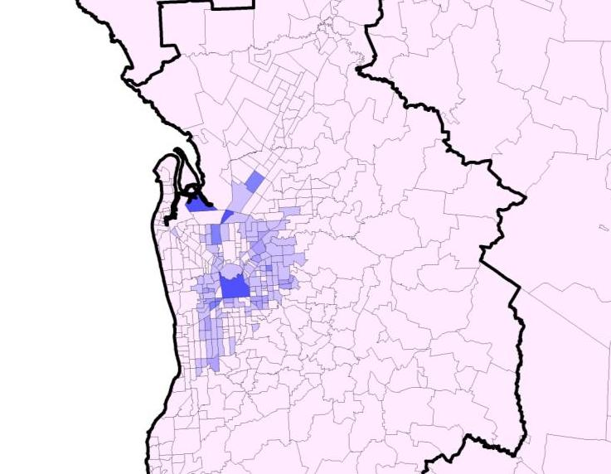
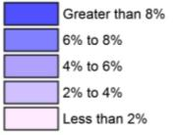
The Chinese-born prefer the city centre and inner suburbs
Gawler
Elizabeth
Tea Tree Gully
Adelaide
Mount Barker
Proportion of persons in Adelaide suburbs born in Mainland China at the 2011 Census
Source: Based on Australian Bureau of Statistics data; KPMG Demographics

Slide 7
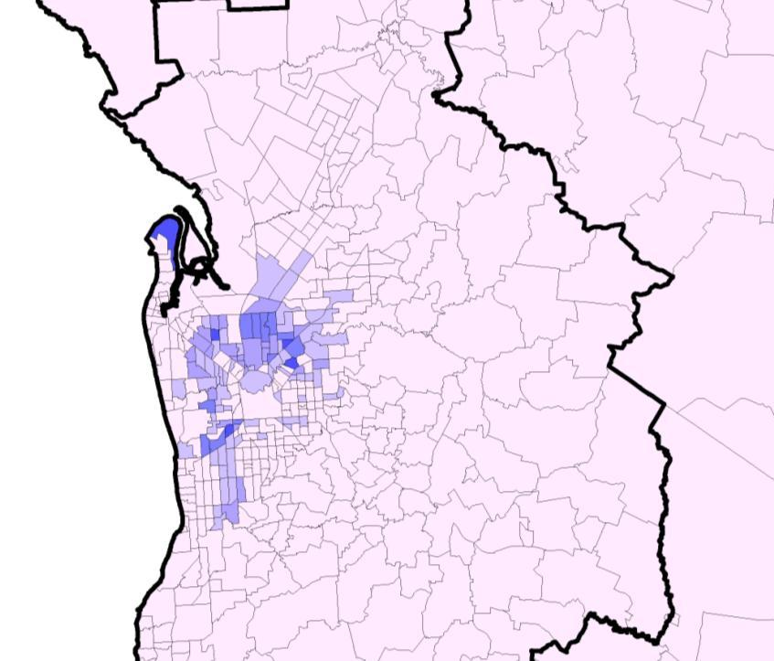
Indians prefer the inner north
Gawler
Elizabeth
Tea Tree Gully
Adelaide
Mount Barker
Proportion of persons in Adelaide suburbs born in India at the 2011 Census
Source: Based on Australian Bureau of Statistics data; KPMG Demographics

Slide 8
Lifestyle, commuter and resource towns are growing fastest in South Australia …
2011 Change
Adelaide 1,103,979 6%
Mount Gambier 25,200 7%
Gawler 23,957 20%
Victor Harbor-Goolwa 23,486 126%
Whyalla 21,736 3%
Murray Bridge 15,968 14%
Crafers-Bridgewater 14,617 9%
Mount Barker 14,452 25%
Port Lincoln 14,086 8%
Port Pirie 13,819 5%
2011 Change
Port Augusta 13,505 2%
Strathalbyn 5,292 36%
Nuriootpa 5,214 18%
Naracoorte 4,909 0%
Millicent 4,796 1%
Roxby Downs 4,702 22%
Kadina 4,468 11%
Renmark 4,388 1%
Tanunda 4,215 1%
Nairne 4,198 21%
1-20 largest urban centres in South Australia at 2011 and per cent change over the previous 5 years (note: the geographic definition of some towns is not consistent)
Source: Based on Australian Bureau of Statistics data; KPMG Demographics

Slide 9
… which places pressure on the state government’s ability to deliver library and other community services
2011 Change
Berri 4,101 2%
Loxton 3,795 11%
Moonta 3,659 9%
Clare 3,277 7%
Wallaroo 3,159 4%
McLaren Vale 3,042 5%
Bordertown 2,550 -1%
Kapunda 2,483 0%
Angle Vale 2,363 73%
Ceduna 2,290 -1%
2011 Change
Mannum 2,166 6%
Willunga 2,094 0%
Hahndorf 2,091 16%
Lobethal 1,957 6%
Angaston 1,942 4%
Barmera 1,913 -1%
Williamstown 1,880 31%
Woodside 1,842 1%
Balaklava 1,829 12%
Two Wells 1,764 146%
21-40 largest urban centres in South Australia at 2011 and per cent change over the previous 5 years (note: the geographic definition of some towns is not consistent)
Source: Based on Australian Bureau of Statistics data; KPMG Demographics

Slide 10
Surge expected in SA’s primary school and retired populations … challenge or opportunity for library services?
2001-2011: 145,000 (from 1.5m to 1.7k)
2011-2021: 160,000 (from 1.7m to 1.8k)
Retirees
Volunteering
Mentoring
Illiteracy escalates
Mature adults
Business owners
Re-skilling
Literacy deteriorates
35,000
Young adults
Household formation
Job seekers
Literacy improved
30,000
25,000
20,000
Kids & teenagers
Pre-school
Early primary
Literacy issues
15,000
10,000
5,000
0
-
5,000
-
10,000
0
-
4
5
-
9
10
-
14
15
-
19
20
-
24
25
-
29
30
-
34
35
-
39
40
-
44
45
-
49
50
-
54
55
-
59
60
-
64
65
-
69
70
-
74
75
-
79
80+
2001-11
2011-21
Net change in South Australia by 5-year age group over 10 years to 2011 and 10 years to 2021
Source: Based on Australian Bureau of Statistics data; KPMG Demographics

Slide 11
Increasing life expectancy is creating new stages of the lifecycle … with enhanced demands on library services?
Child
Adolescence
Adult
Lifestyle
Retired
Old
2013
82
Child
Teen
Adult
Old
1973
71
Child
Adult
Old
1933
63
0
10
20
30
40
50
60
70
80
90
Change in life expectancy over 80 years in Australia
Source: Based on Australian Bureau of Statistics data; KPMG Demographics

Slide 12
Meet the new ‘surging silver consumer’ … here are Boomers redefining how life is lived beyond the 50s
$60,000
140%
34
61
$50,000
120%
100%
$40,000
47
80%
$30,000
60%
$20,000
40%
$10,000
20%
$
-
15
17
19
21
23
25
27
29
31
33
35
37
39
41
43
45
47
49
51
53
55
57
59
61
63
65
67
69
71
73
75
77
79
81
83
85+
0%
% Change 2001 to 2011
Median Total Personal Income 2011
Median Total Personal Income 2001
Percentage change in personal income by age of income earner (>$1 p.a.) between 2001 & 2011 with average income per person in 2001 & 2011
Source: Based on Australian Bureau of Statistics data; KPMG Demographics

Slide 13
There has been a shift in the Australian economy … away from manufacturing and towards healthcare
5 years May 2003 – up 1.4m (9.5m – 10.8m)
Healthcare
5 years May 2013 – up 840k (10.8m – 11.7m)
300,000
Professionals
Public Admin & Safety
250,000
200,000
Education & Training
150,000
100,000
50,000
-
-
50,000
-
100,000
Manufacturing, Agriculture, Rental/Real Estate
-
150,000
-
200,000
Mining
Retail
Accom & Food
Admin & Support
Wholesale
Construction
Other services
Manufacturing
Education &Training
Arts & Recreation
Financial & Insurance
Info Media/Telecoms
Healthcare/Social Assist.
Public Admin & Safety
Elect, Gas, Water, Waste
Rental/Hiring/Real Estate
Professional/Scientific/Tech.
Transport, Postal, W’Housing
Agriculture/Forestry/Fishing
2003-2008
2008-2013
Net change in total jobs in Australia over two successive five-year periods, May 2003 – May 2013
Source: Based on Australian Bureau of Statistics data; KPMG Demographics

Slide 14
South Australia is shifting away from manufacturing and into a services economy … perhaps requiring new skills
Change 2006-2011 No.
General Clerk 3,800
Aged or Disabled Carer 2,800
Checkout Operator 2,000
Truck Driver (General) 1,500
Electrician (General) 1,500
Accounts Clerk 1,400
Child Care Worker 1,400
Carpenter 900
Personal Care Assistant 900
Sales Assistant (General) 900
Change 2006-2011 No.
Kitchenhand 900
Barista 800
Chef 800
Fitter (General) 700
Miner 700
Commercial Cleaner 700
Building Associate 600
Registered Nurse (Critical Care and Emergency) 600
Cafe Worker 600
Waiter 600
* Not in Australian Top 20
Net change in employment by occupation in South Australia over 5 years to 2011
Source: Based on Australian Bureau of Statistics data; KPMG Demographics

Slide 15
Fewer jobs in manufacturing and agriculture … the state must engage with the knowledge economy
Change 2006-2011 No.
Product Assembler -2,500
Secretary (General) -2,000
Vineyard Worker -1,200
Mixed Crop and Livestock Farmer -1,000
Corporate Services Manager -700
Metal Engineering Process Worker -600
Grape Grower -500
Credit or Loans Officer -500
Toolmaker -500
Fruit or Nut Grower -300
Change 2006-2011 No.
Product Examiner -300
Motor Mechanic (General) -300
Plastics Factory Worker -300
Chief Exec. or Managing Director -300
Recycling or Rubbish Collector -300
Shelf Filler -200
Switchboard Operator -200
Sales Representative (Personal and Household Goods) -200
Family Day Care Worker -200
Winery Cellar Hand -200
* Not in Australian Bottom 20
Net change in employment by occupation in South Australia over 5 years to 2011
Source: Based on Australian Bureau of Statistics data; KPMG Demographics

Slide 16
Australia’s library staff is ageing … does this mean there is opportunity for, or risk of, generational change?
2006: 24,850
2011: 24,840
Change: -10 or 0%
48% of Library Staff* were aged 50+ at 2011 Census
5,000
4,500
4,000
3,500
3,000
2,500
2,000
1,500
1,000
500
0
15
-
19
20
-
24
25
-
29
30
-
34
35
-
39
40
-
44
45
-
49
50
-
54
55
-
59
60
-
64
65+
2006
2011
* This Library Staff category is the combination of Librarians, Library Technicians and Library Assistants
Age profile of Library Staff* between the 2006 and 2011 Censuses
Source: Based on Australian Bureau of Statistics data; KPMG Demographics

Slide 17
Baby boomers will re-engineer retirement in the coming decade … beware the rise of the grumpy retiree!
1950
2000
2050
160,000
140,000
140,000
120,000
100,000
80,000
60,000
40,000
20,000
-
1950
1955
1960
1965
1970
1975
1980
1985
1990
1995
2000
2005
2010
2015
2020
2025
2030
2035
2040
2045
2050
Net growth in population aged 65+ over 100 years in Australia
Source: Based on Australian Bureau of Statistics data; KPMG Demographics

Slide 18
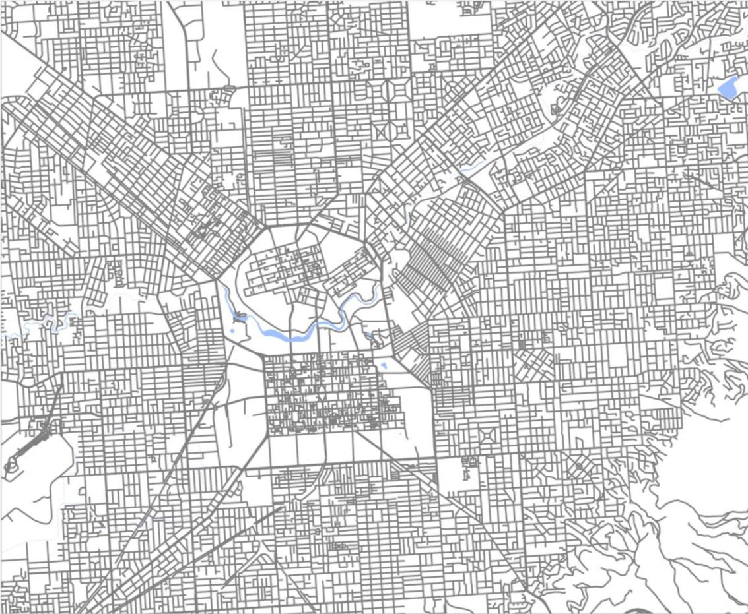
Introducing Adelaide’s bachelor hotspot …
Vale Park
1.56:1
Trinity Gardens
Glenside 1.34:1
Hotspot suburbs for single men and women aged 25-34 at the 2011 Census
Source: Based on Australian Bureau of Statistics data; KPMG Demographics

Slide 19
Contact
Bernard Salt
KPMG Australia
+61 3 9288 5047
bsalt@kpmg.com.au
www.bernardsalt.com.au
twitter.com/bernardsalt
linkedin.com/in/bernardsalt
facebook.com/BernardSaltDemographer

