Slide 1
Mitcham Memorial Library
PLSA presentation April2019

Slide 2
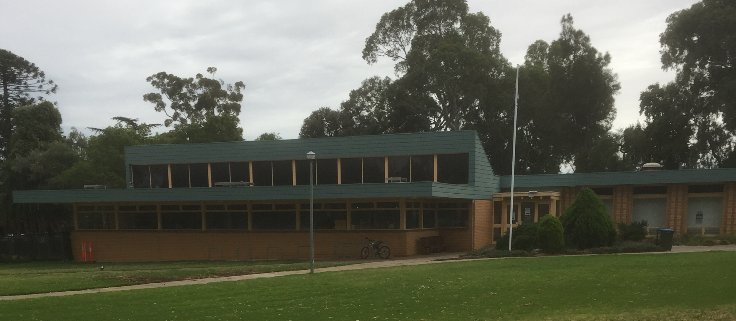
What was wrong?
Tired building
Noise controls
Poor accessibility
Lack of space
Infrastructure
Notes:
Infrastructure – air conditioning, leaking roof, toilets blocking,

Slide 3
Timeline of Project
September 2016 – advised of plan
February 2017 – SLGIP Grant awarded
June 2017 – community consultation
August 2017 – Council decision to build
December 2017 – sod turning ceremony
April 2018 – First stage
June 2018 – Second stage
January 2019 – official opening

Slide 4
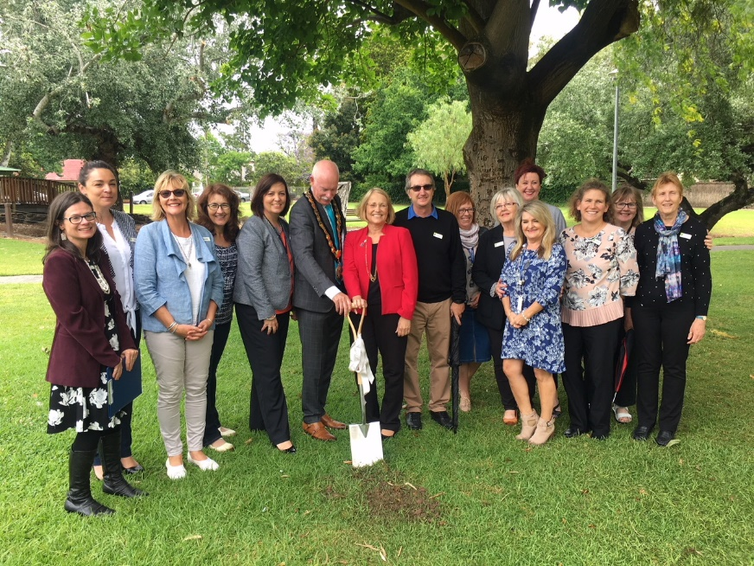
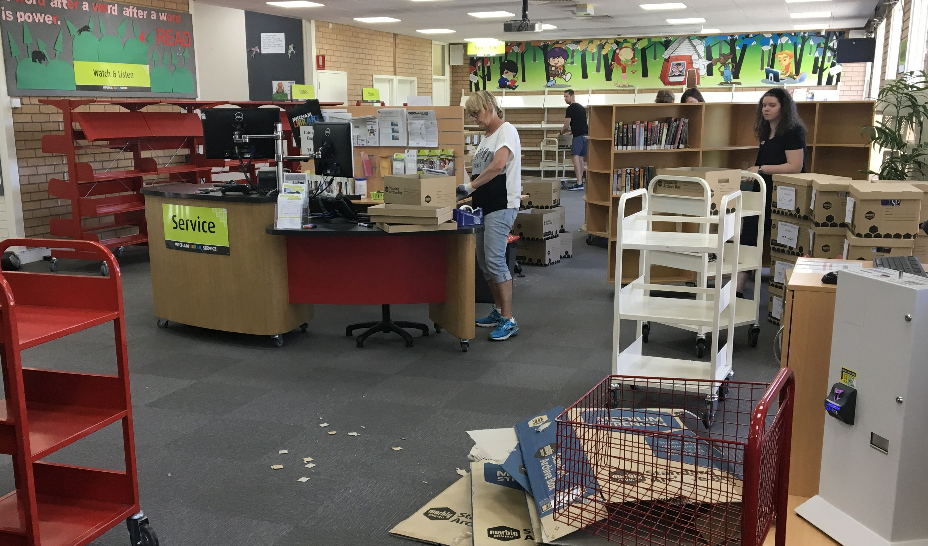
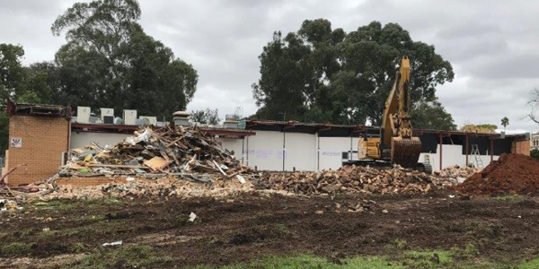
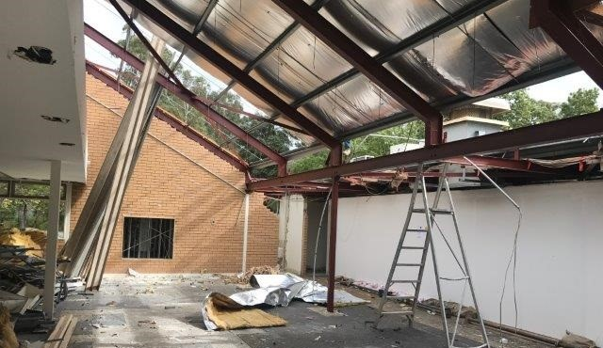
December 2017 – it begins…..
Notes:
7th December 2017 – sod turning ceremony
Early 2018 – site preparation.
April 2018 - Hawthorn Community Centre established as library
July 2018 – Mitcham Library totally closed .
July 2018 – North car park completed.
November 2018 – lockup stage
December 2018 – completed building
January 2019 – completion checks and relocation of services, testing.
January 23rd 2019 – official opening ceremony
January 29th 2019 – open to public
February 16th 2019 – Family fun day

Slide 5
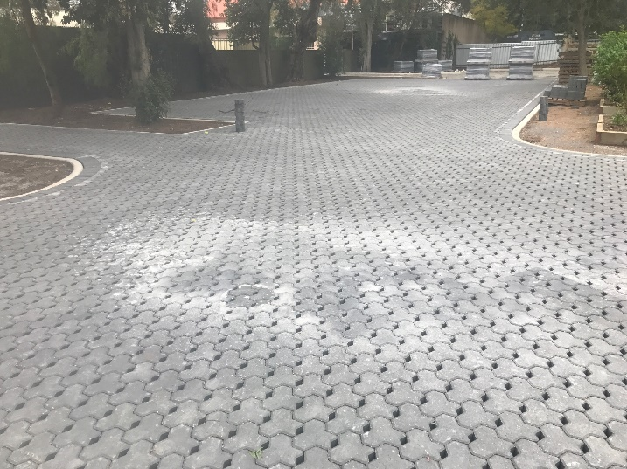
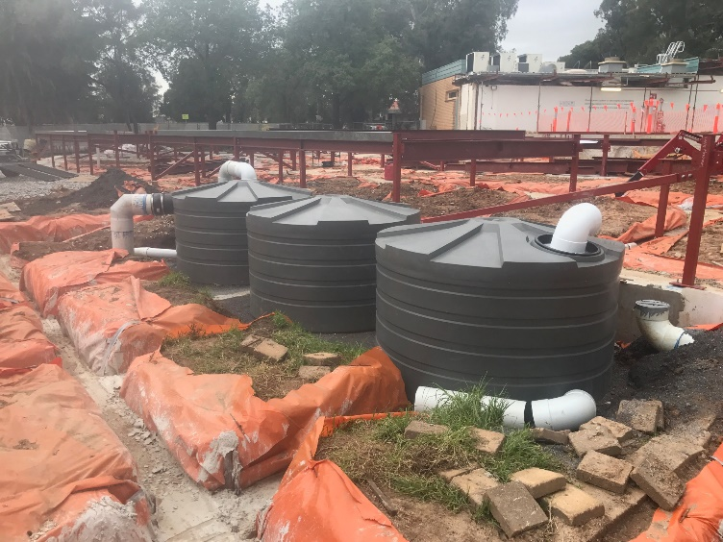
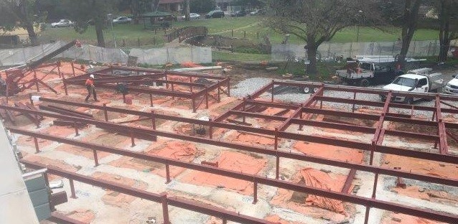

Slide 6
Library layout

Slide 7
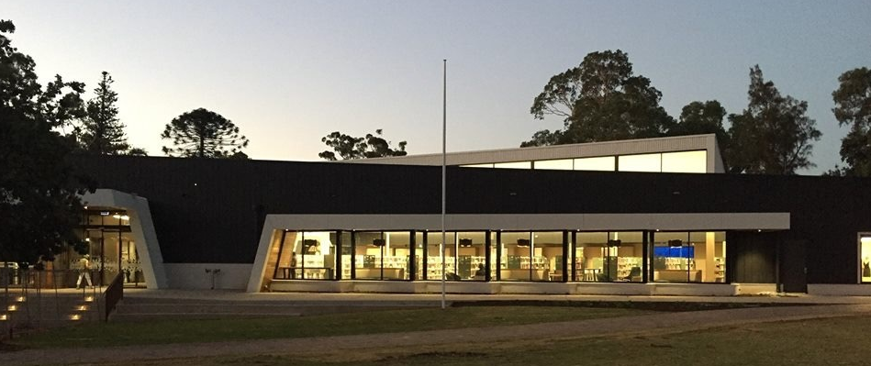
The new Mitcham Memorial Library

Slide 8
Details
$6.4M (inc. $1M from SLGIP Grant)
Increase from 746m2 to 1,476m2
Compliant
Integrated Toy Library
Five meeting rooms
Parenting room
Gallery
Storage room
Flexible children’s area
Public kitchen
Youth zone
Internal smart chute
External deck
Notes:
Meet and greet
Adhoc advice/referrals/research/assistance
Shelving, shelf reading, tidy
Phone enquiries
Recording of statistics – manual and online
Floor roaming
Safety assessments
Monitoring of the user experience
Computers and portable device assistance
Shift handovers
Mixture of qualified and unqualified

Slide 9
Key priorities from consultation
Warmth
Embrace the outside
Respect the Soldiers Memorial Reserve
Connect with the creek
Conservative colours
Noise control
Classic modern design
Environmental initiatives
Cheap

Slide 13
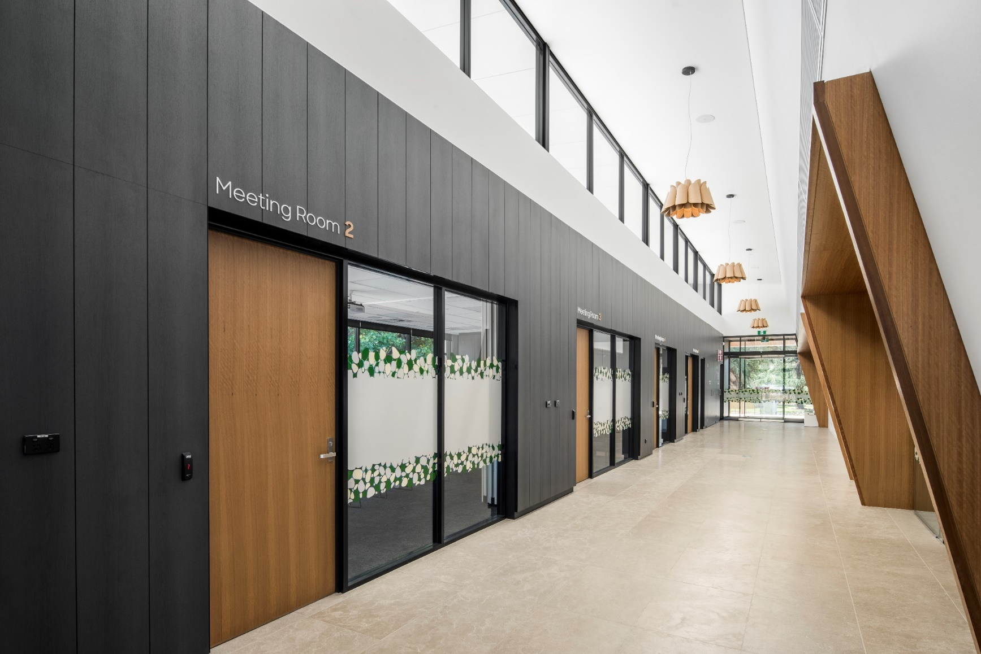

Slide 14
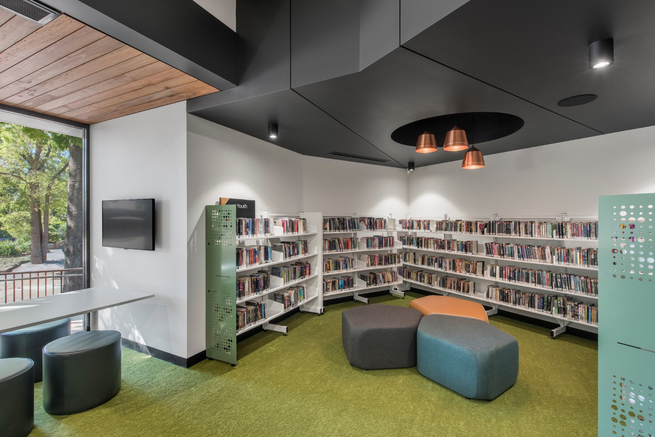

Slide 15
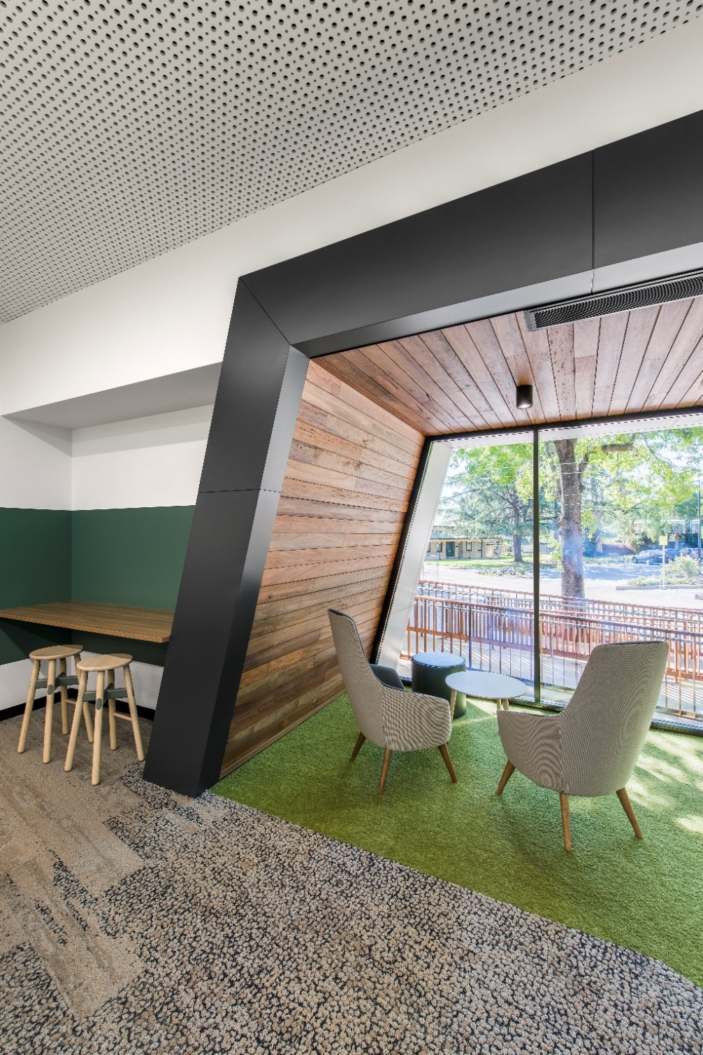

Slide 16
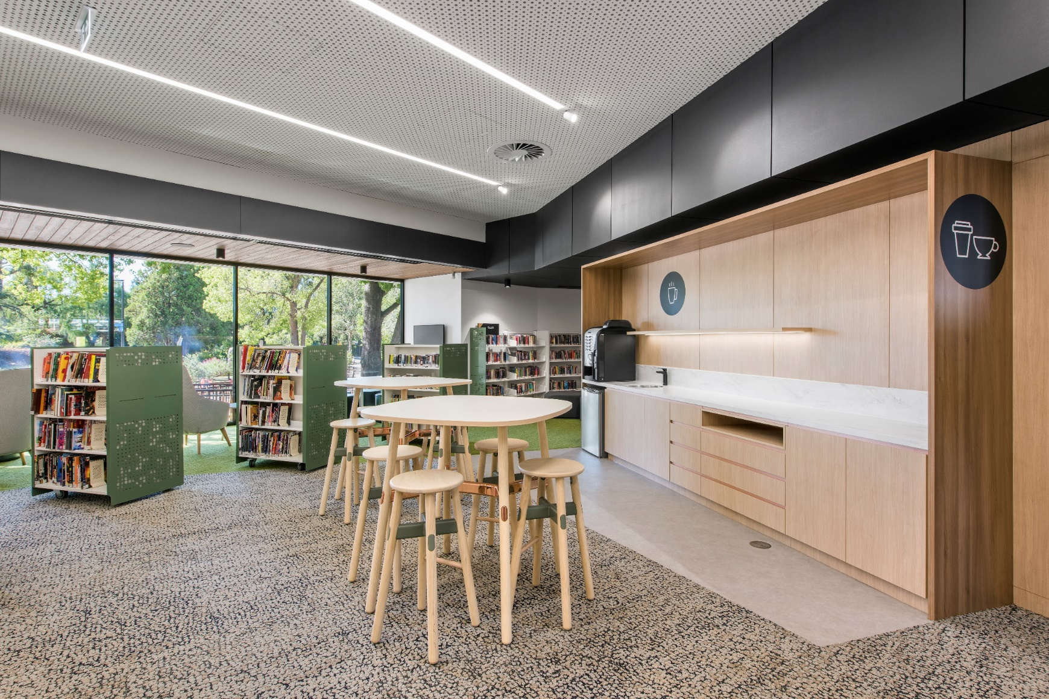

Slide 17
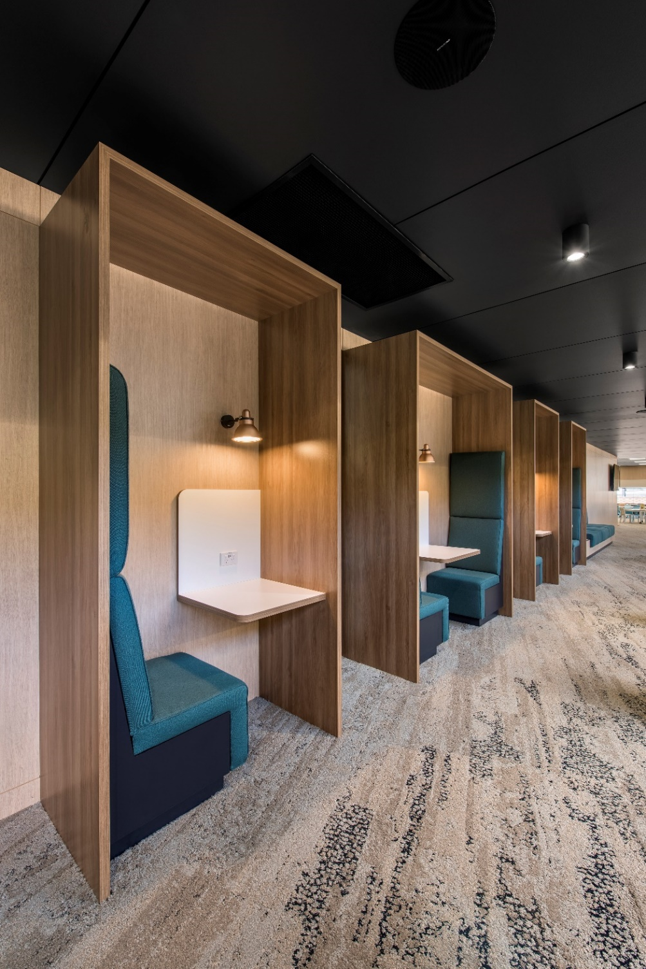

Slide 18
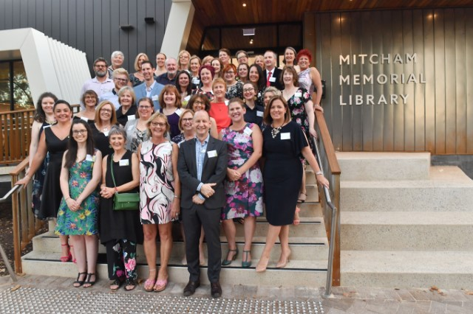
We got there!

Slide 19
Questions?
Ursula Hickey
Manager, Library Services
uhickey@mitchamcouncil.sa.gov.au
Ph: 0423614665
www.mitchamcouncil.sa.gov.au

