Slide 1



South Australian Public Library Network
Digital use – the demands of our digital community users
Emily Wilson
Supplier Content Librarian
Sarah Powell
Collections & Content Librarian
PLSA Network Meeting
1 April 2019

Slide 2

What we’ll cover today
Digital Content as a collection & a service
The eLending Project
Digital Collection Management Life-Cycle
Curation of collections
Current usage information
A comparison in collection size & usage
Q&A

Slide 3
Digital Content as a collection and a service
* has a lower collection lifecycle cost *helps foster digital literacy
* helps libraries extend collection into new media, offering new & improved services
* attracts new library users*

Slide 4
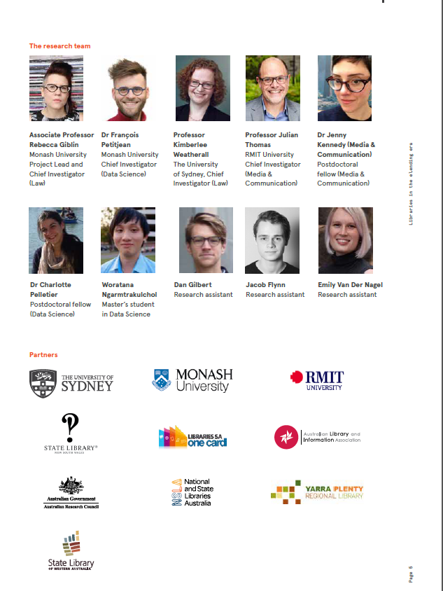
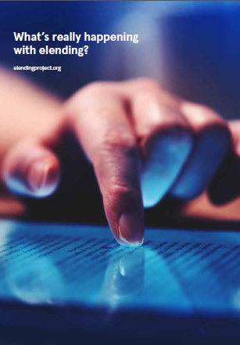
The eLending environment

Slide 5
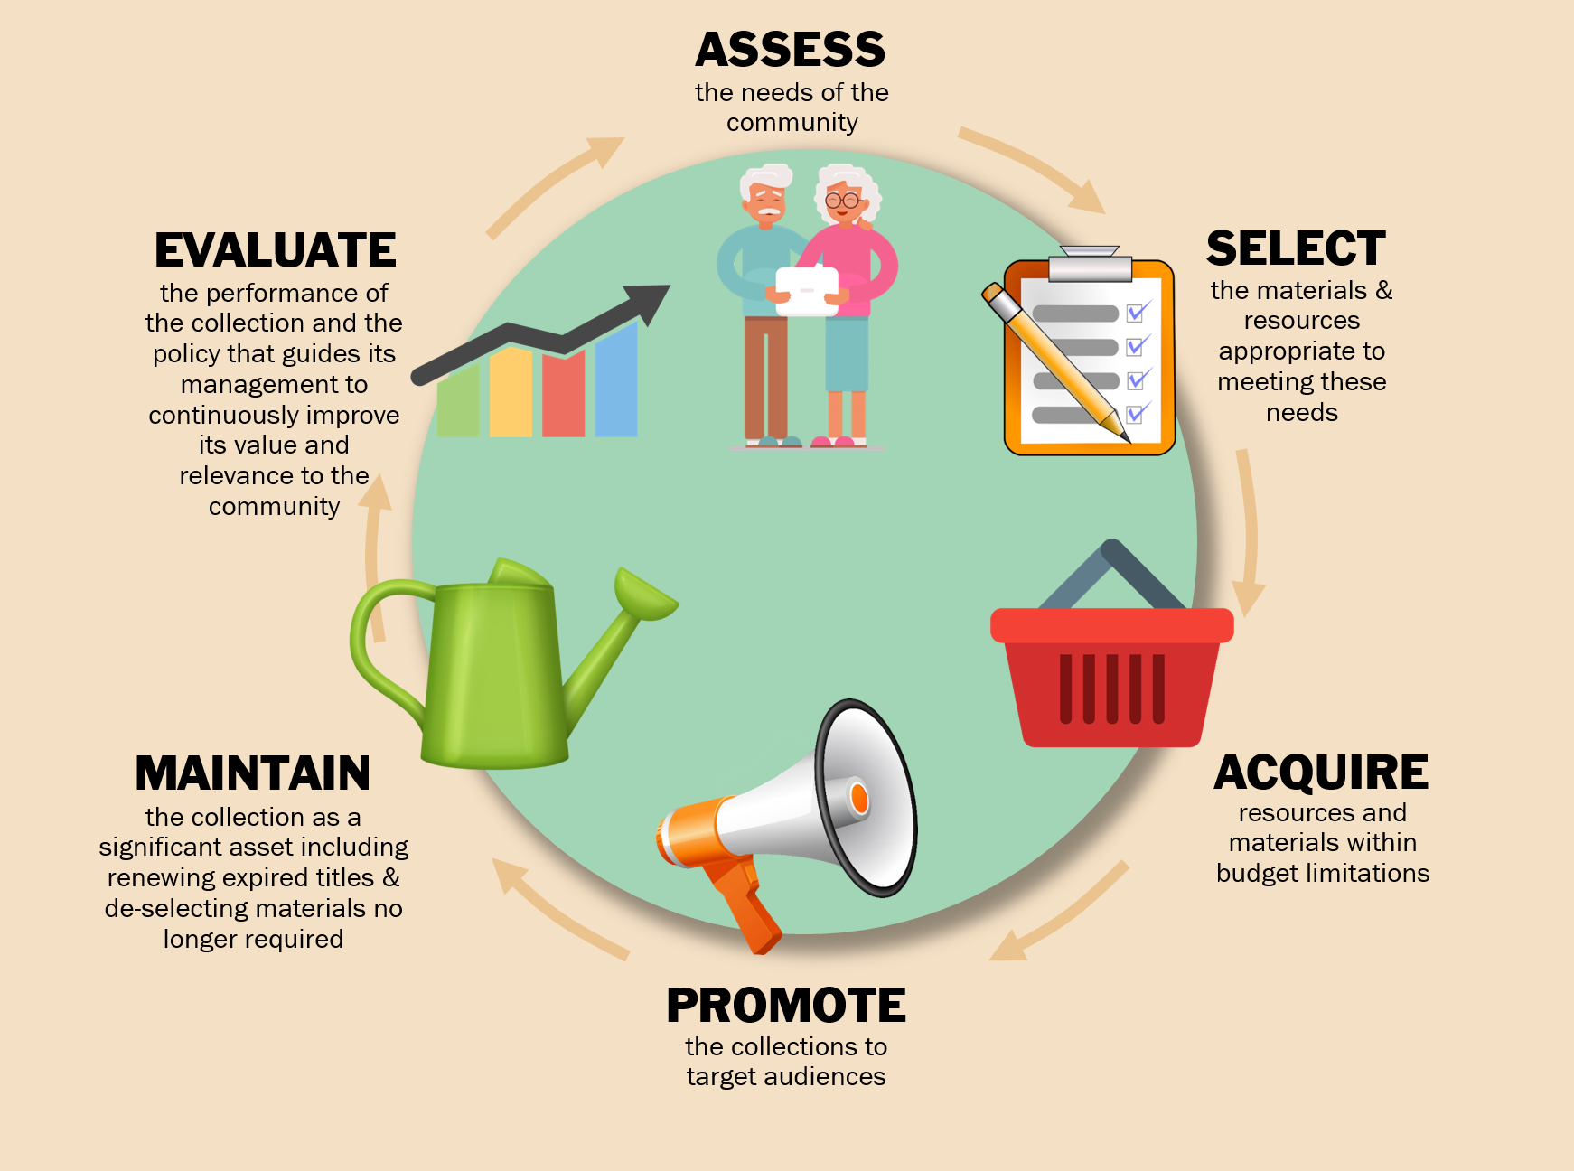
Digital Collection Management Life-Cycle

Slide 6

Curated Collections
Place your screenshot here
Mental Health & Wellbeing
Everyone’s Reading
Celebrating Aboriginal Australian Writing
LGBTIQ Fiction
Pregnancy& Parenting
I Choose SA
Premier’s Reading Challenge
Resources for Library Professionals
and many more…

Slide 7
Upwards Trend
For:
Usage Statistics
User Registrations
2018
2017
2016

Slide 8
2,760,700
eBooks & Audiobooks loaned since inception
(as of March 28 2019)

Slide 9
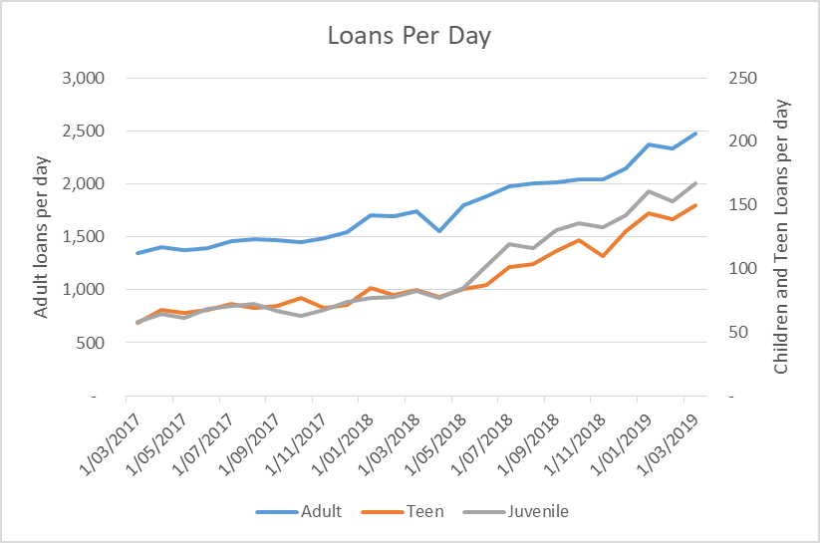
Monthly Loans
Place your screenshot here
Average loans per day

Slide 10

Where do our customers live?
Our Country and SCL customers borrow digital items at the same rate as they borrow physical items
Evidence for equivalent;
- internet access
- digital literacy
- promotional access

Slide 11
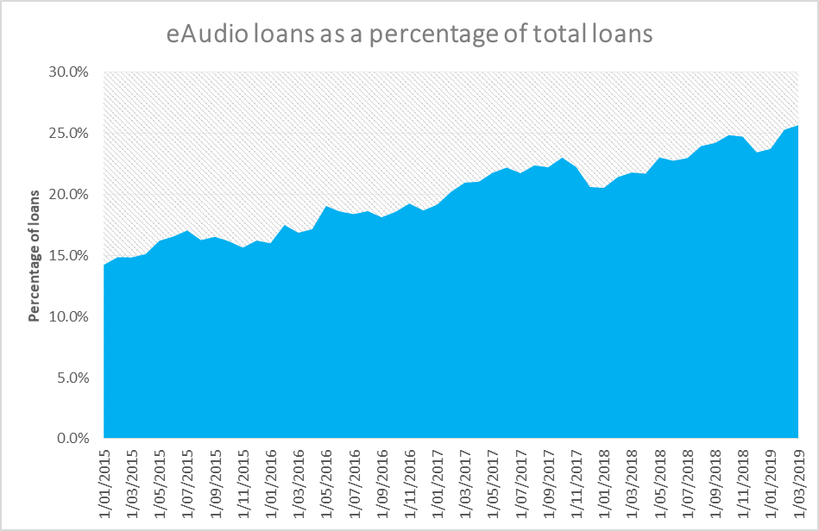
What format is preferred?
Place your screenshot here
Audio continues to increase in popularity

Slide 12
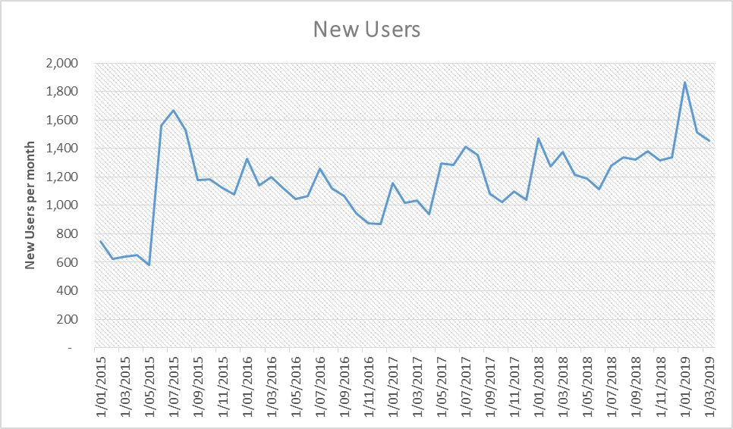
Are we attracting new customers?
Place your screenshot here

Slide 13
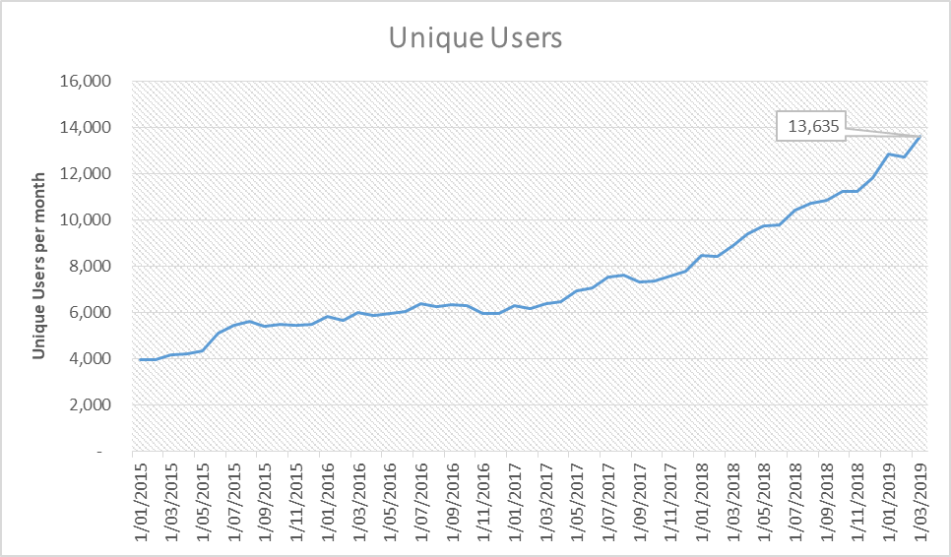
How many people are using our collections?
Place your screenshot here
Are our new customers returning?

Slide 14
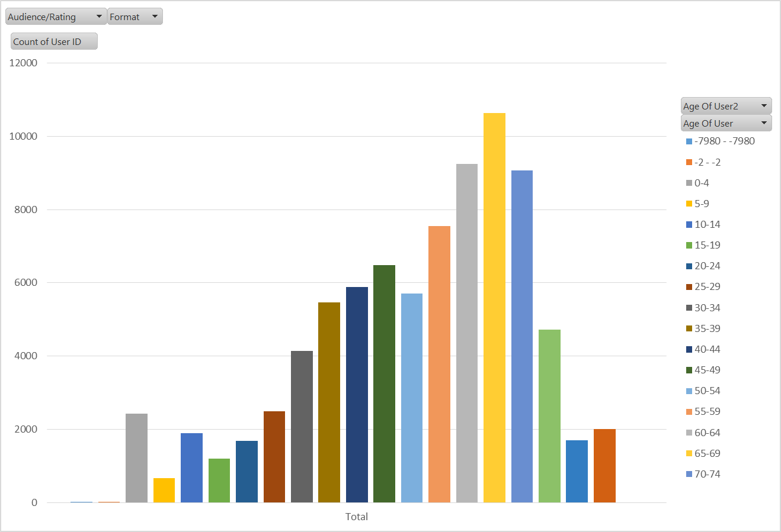
Who is using our collections?
Place your screenshot here
In January, 10,624 items in our digital collection were checked out to customers 65-69 years old

Slide 15
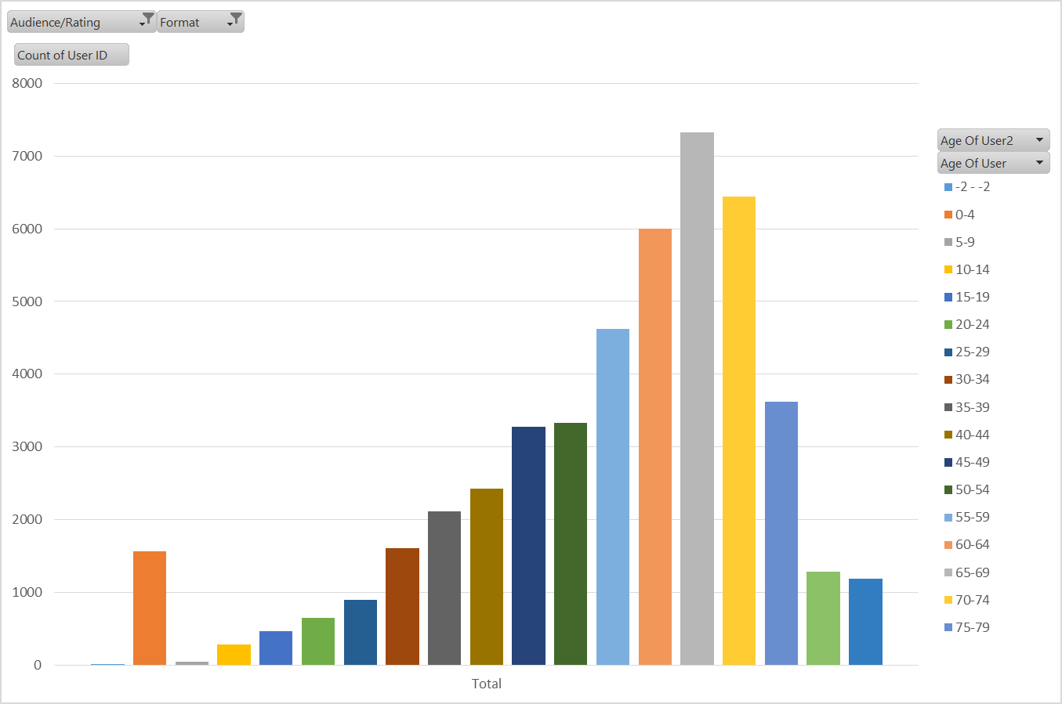
Who is using our collections?
Place your screenshot here
Adult Fiction eBooks
7,323 loans were made to people 65-69 years old

Slide 16
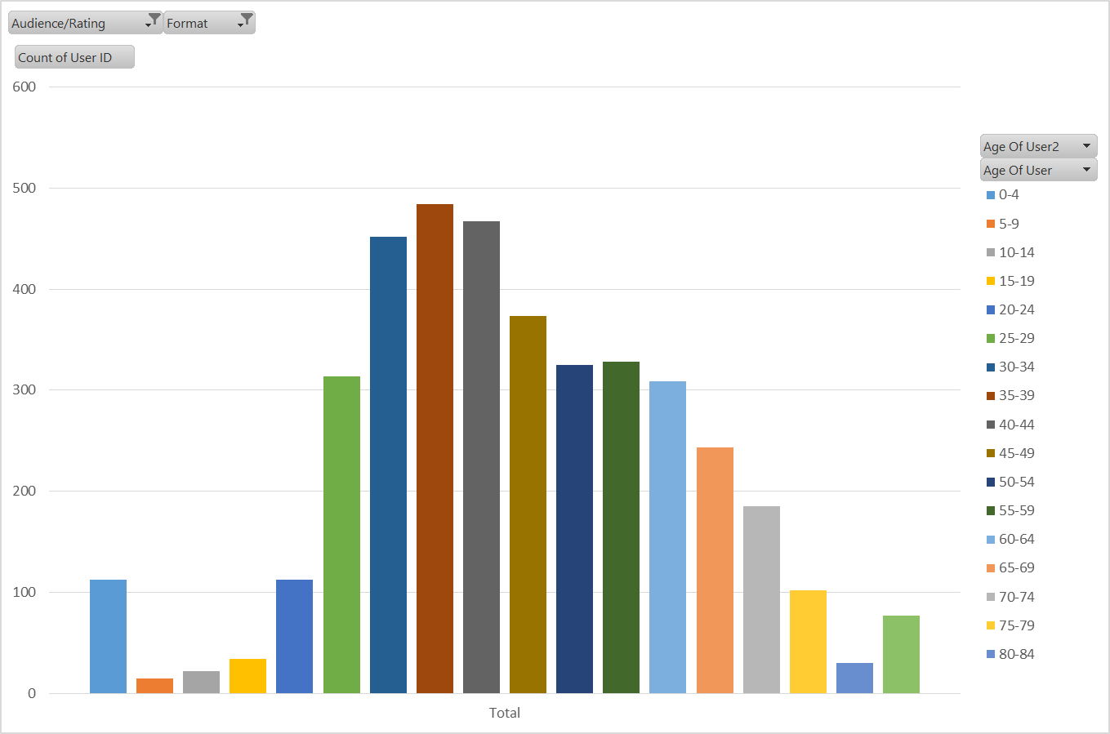
Who is using our collections?
Place your screenshot here
Adult Non Fiction Audio
484 loans were made to people 35-39 years old

Slide 17
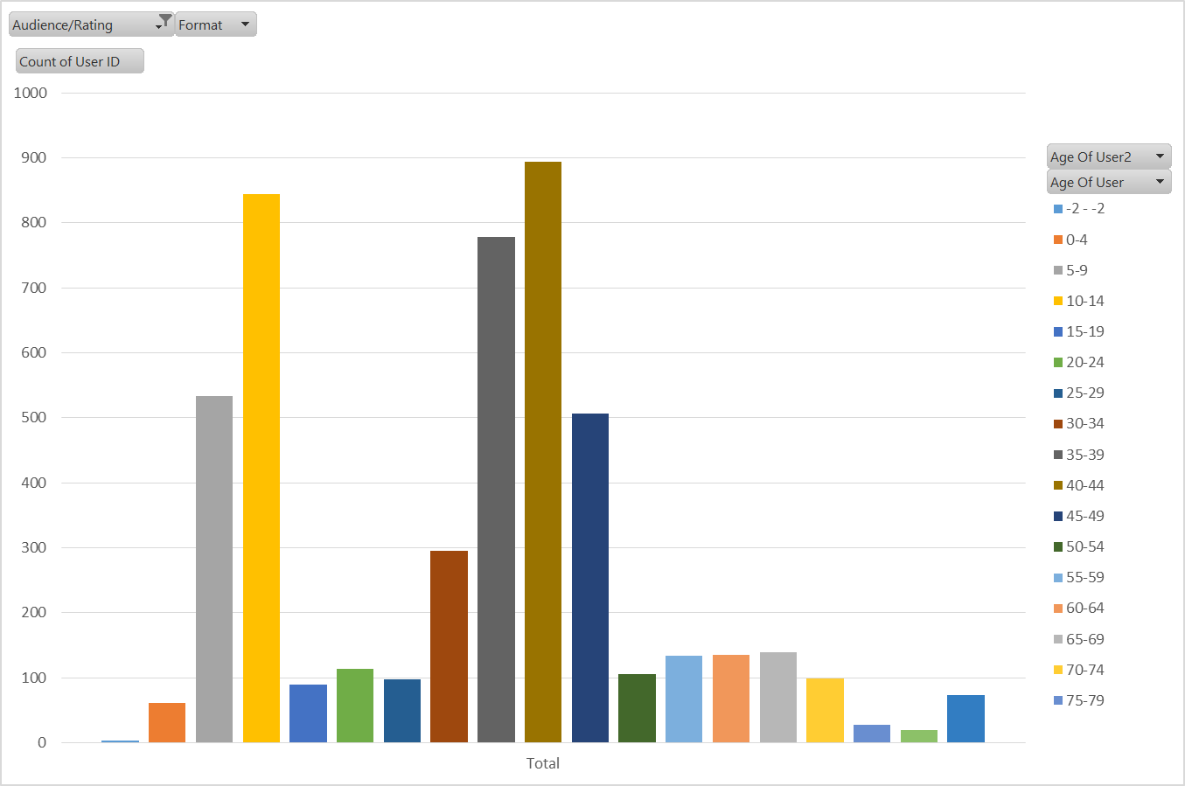
Who is using our collections?
Place your screenshot here
Children's
Children are more likely to access our collection on an adult’s account

Slide 18
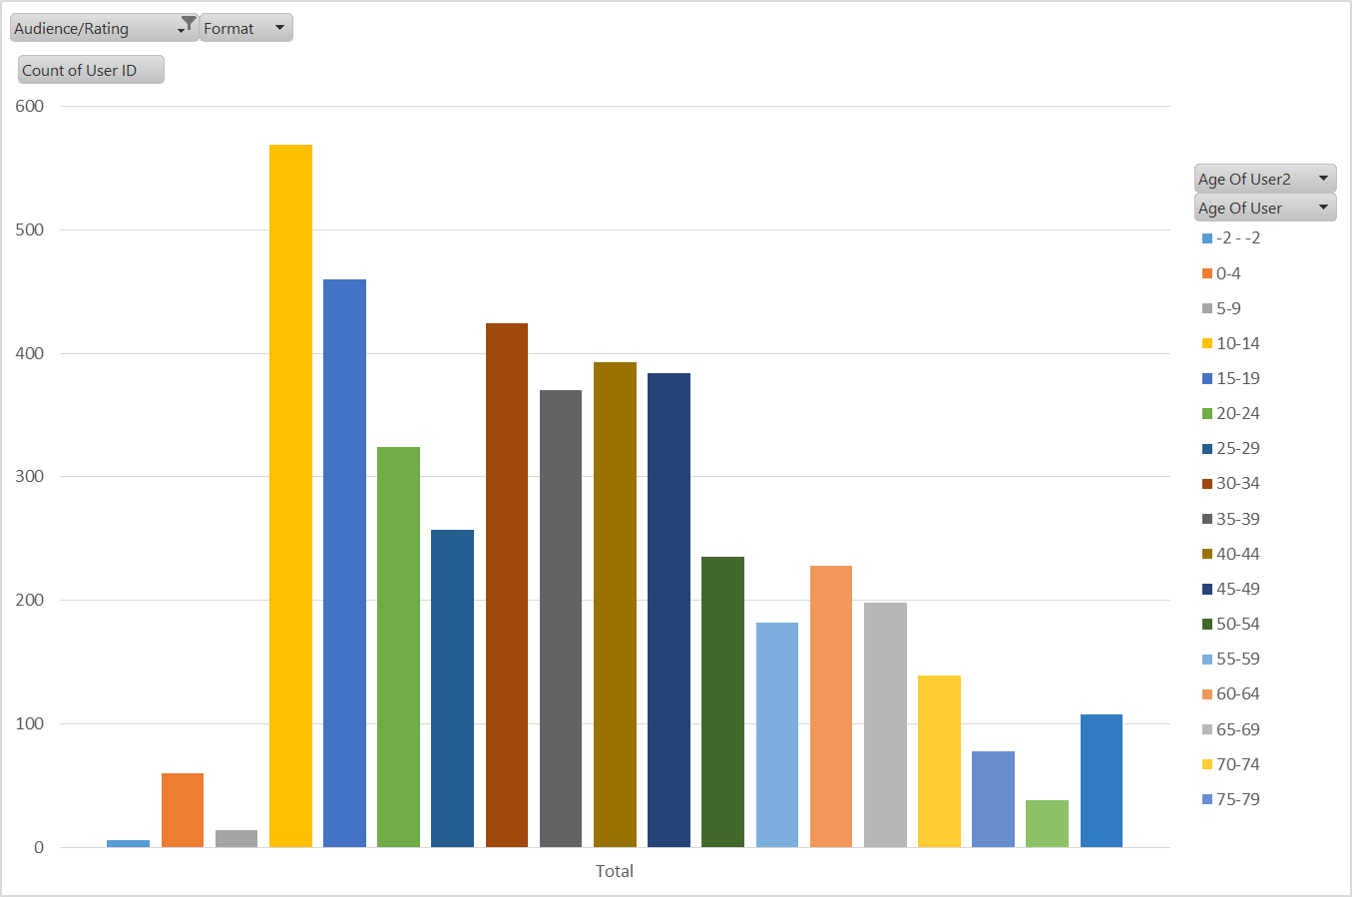
Who is using our collections?
Place your screenshot here
Young Adults
Data shows us that this collection is being consumed across all customer age groups

Slide 19
A comparison in collection size & usage
Auckland Council Libraries have the best performing OverDrive Collection in the Southern Hemisphere.
Auckland Libraries customers check out approx.:
4600 eBooks and Audiobooks every day
The SAPLN customers check out approx.:
2600 eBooks and Audiobooks every day
The Auckland Libraries collection sits at approx.:
246,400 titles
The SAPLN collection sits at approx.:
45,300 titles
Population of Auckland approx.:
1.6 million
Population of South Australia approx.:
1.7million

Slide 20

Thank-you and questions
Emily Wilson
Supplier Content Librarian
Sarah Powell
Collections & Content Librarian
PLSA Network Meeting
1 April 2019

