Slide 1
Tomorrow’s Libraries Review
PLSA Update

Slide 2
Consultation on the review
To date:
Review Working Group
Public Library Services Standing Committee
The 8 largest library services (Charles Sturt, Marion, Mitcham, Playford, Port Adelaide Enfield, Onkaparinga, Salisbury, Tea Tree Gully)
The capital city library (Adelaide)
Public Library Services
Community Centres SA
Industry leaders/advisors
PLSA network meeting
Coming:
Focus group re early findings/directions
Draft Recommendations to be workshopped in 5 regional sessions + webinar (Sept)

Slide 3
Why review Tomorrow’s Libraries?
It’s time (and the review is an action in TL)
A lot has changed:
We live in digital (no longer just predicting its arrival)
Pressure on library budgets
Co-located services
Publishing economics
Decreased membership/loans, increased visitation
Service/space/interface shift to User Experience
Measures aren’t capturing what we’re doing
Libraries are supporting government online services
Workforce skills aren’t keeping up
Most of the projects have been actioned… so what’s next?

Slide 4
Review perspectives
Micro Progress on projects and activities set out in Tomorrow's Libraries, including consideration of whether these were the right projects/activities to deliver the network’s strategy, and what we learned from implementation.
Macro Future directions, and the development of recommendations to ensure the library network is anticipating and responsive to local and international trends, and is efficient and effective in the delivery of library services.

Slide 5
Observations about TL activities
No timelines, but push to complete asap
Lead agency sometimes too vague (‘Council’, ‘Libraries’)
Digital activities have been bundled in to Digital Strategy
Co-location of services has changed emphasis for some activities

Slide 6
What has been achieved?
Of the 37 actions in Tomorrow’s Libraries:
21 in progress: ‘business as usual’ or improvement upon a successful activity
6 have been implemented, it is now up to library services to use the outcomes (e.g. Workforce Development Plan)
5 were the responsibility of ‘Local Government’ or ‘Libraries’ without a clear mechanism to activate, monitor or assess
5 not actioned, mainly due to role clarity

Slide 7
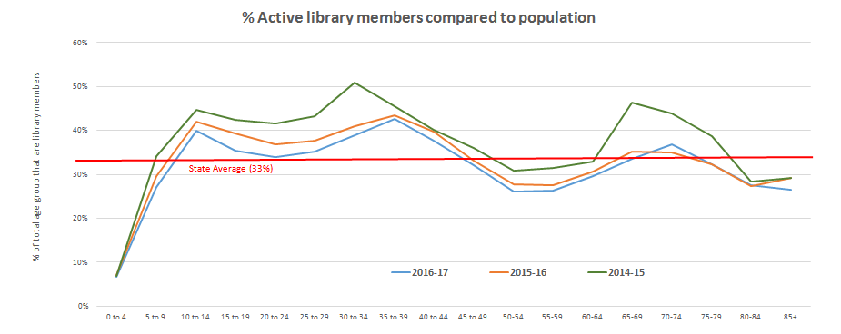
Thoughts to frame the future

Slide 9
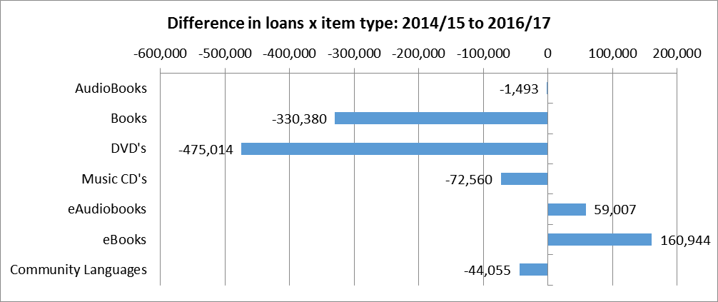

Slide 10
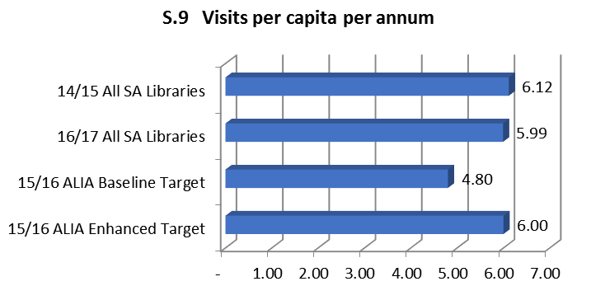

Slide 11
Early-stage directions
Governance: large library leadership
Powerful messages about modern libraries
Transporting the collection: cost and convenience
Disrupting library culture – from transactional to user experience
Measures!
and…

Slide 12
Consortium efficiency opportunities:
Shelf ready
Supplier assisted procurement for standard lists
Coordinated research and interpretation of data
Central pool of casual staff
Staff classifications for co-located services
Programs strategy
Content streaming
Centralised notices/sms
Simplified payments
Coordinated membership drive
Network coordination of selections and collection management
If there is less money and greater community expectations… what savings and efficiencies can we achieve as a network?

Slide 13
First thoughts?

Slide 14
More opportunities for feedback
4th Sept Port Pirie
6th Sept Naracoorte
11th Sept Berri
12th Sept Hallett Cove (morning)
12th Sept Para Hills (afternoon)
Webinars 19th Sept (morning and afternoon options)

