Slide 1


Slide 2
Languages Direct
LOTE Express
Shelf-Ready
Selection Days
Customer Portal

Slide 3

















Beyond Victoria

Slide 4
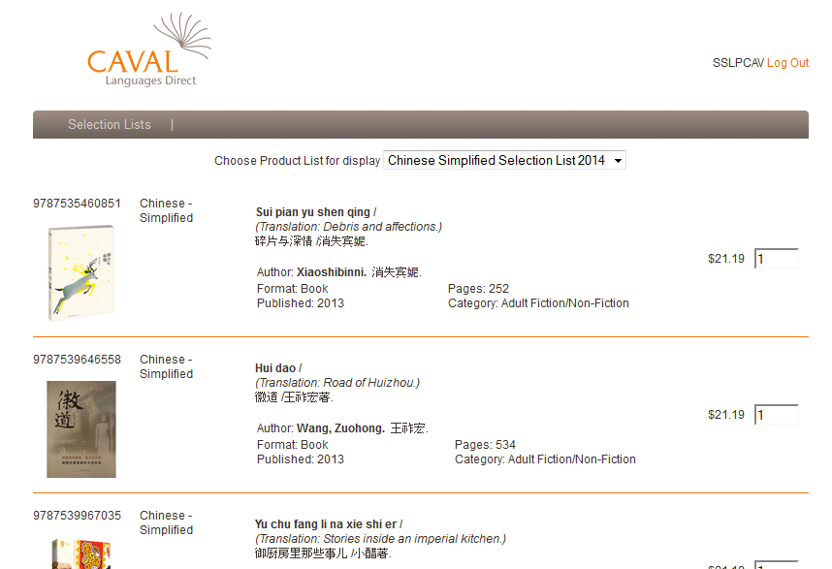
Customer Portal

Slide 5

The Process

Slide 6
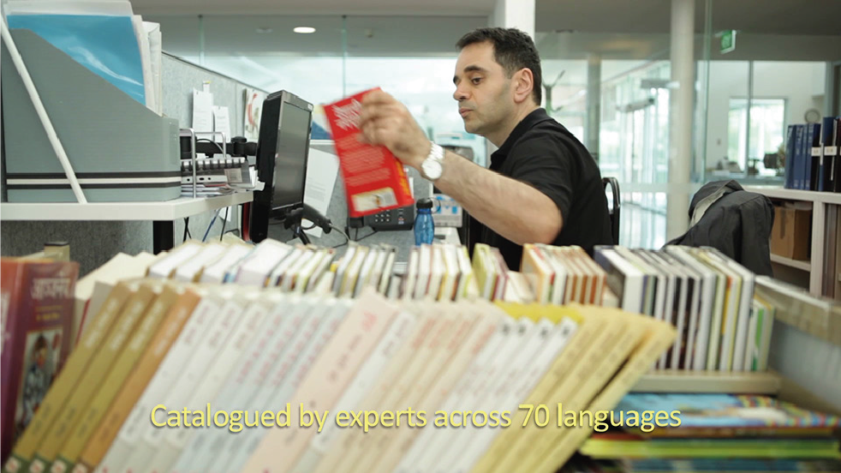
70 different languages

Slide 7
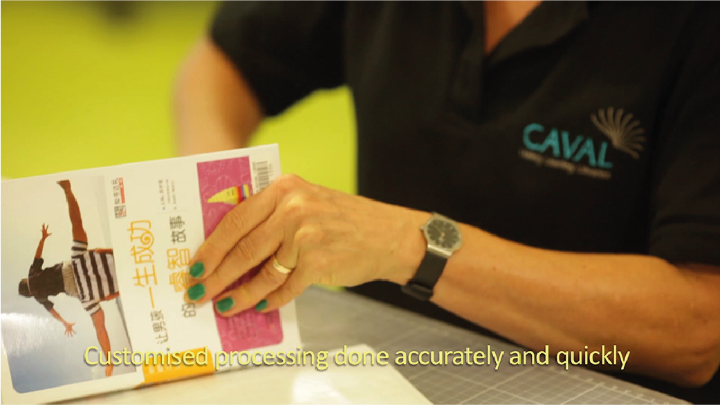
Customised processing

